Slide 1
“Prediction of Diabetes in Females of Pima Indian Heritage: A Complete Supervised Learning Approach” SUMMARY
Mirjam Nilsson

Slide 2
INTRODUCTION
In this paper, the designed model predicts the diabetes of females of Pima Indians heritage by taking the clinical dataset. Here, this problem is considered as a binary classification problem. Therefore, supervised learning algorithms have been used, such as classification tree (CT), support vector machine (SVM), k-Nearest Neighbour (k-NN), Naïve Bayes (NB), Random Forest (RF), Neural Network (NN), AdaBoost (AB) and Logistic Regression (LR). We use the female Pima Indians diabetic dataset from Kaggle and UCI data repository and k-fold cross-validation to carry out the process of training and testing.

Slide 3
METHODOLOGY

Slide 4
DATASET
The datasets consists of several medical predictor variables and one target variable, Outcome. Predictor variables includes the number of pregnancies the patient has had, their BMI, insulin level, age, and so on.
The dataset, Pima Indians Diabetes Database, is stored in Kaggle and UCI data repository. This dataset is originally from the National Institute of Diabetes and Digestive and Kidney Diseases. This dataset is mainly used to predict whether a Pima Indians female has diabetes or not. It was preprocessed, and so minimal pre-processing was required.
Features: Pregnancies, Glucose, Blood Pressure, Skin Thickness, Insulin, BMI, Diabetes Pedigree Function, Age (21+)
Target: Outcome (1 if a patient is diabetic and 0 if otherwise.)
Number Of Instances:768

Slide 5
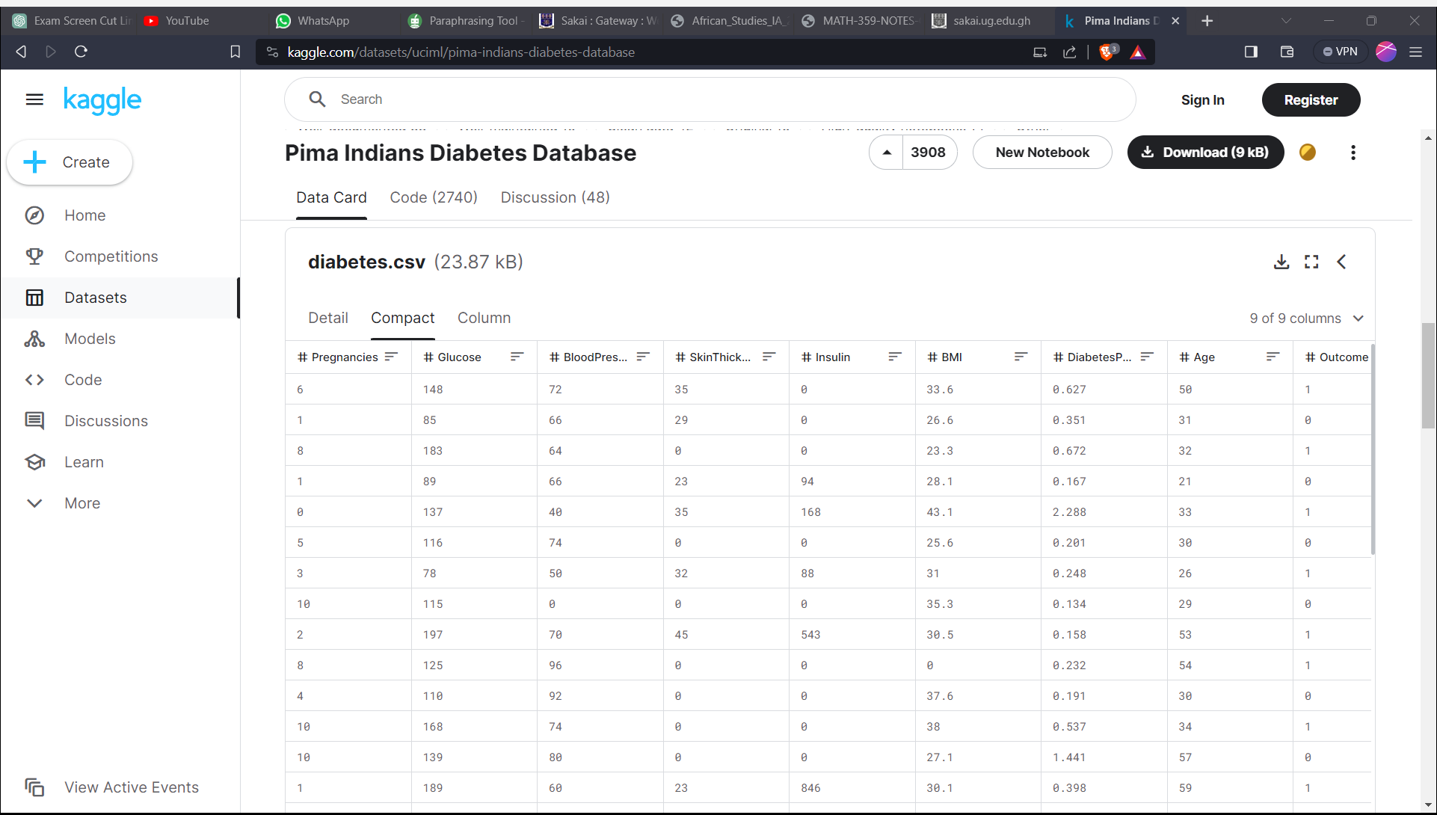

Slide 6
APPROACH
Train multiple models using different learning algorithms
Apply k-fold cross validation
Compute performance metrics and select best model

Slide 7
Algorithms USED: CT, SVM, k-NN, NB, RF, NN, AB and LR algorithms VALIDATION: k-fold cross-validation (10 folds used) PERFORMANCE METRICS: AUC, CA, F1, precision and recall
Richard Branson

Slide 8
Analysis and results

Slide 9
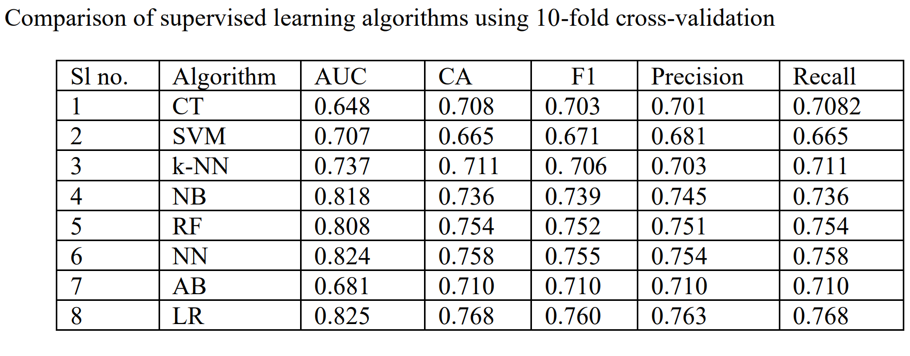

Slide 10
THANK YOU
KWAME ANDERSON
X
DZORKA BLESS
@kwam_e13

